Slide 1
.NET for IT Pros
Cory Knox

Slide 2


Slide 3

Cory Knox
Mastodon: @corbob@fosstodon.org
Twitter/X: @CoryKnox
GitHub: corbob
LinkedIn: KnoxCory
Website: coryknox.dev
Discord: .corbob

Slide 4

#hungryCory

Slide 5
What is .NET?
.NET is the free, open-source, cross-platform framework for building modern apps and powerful cloud services.

Slide 6
It’s not a tool that is replacing another, but a tool to complement the other.

Slide 7
.NET vs PowerShell
Method -> Function
Arguments -> Parameters
Classes -> Classes
Cmdlets -> It's complicated…

Slide 8
But I'm Learning PowerShell… not .NET

Slide 9
Real world examples

Slide 10
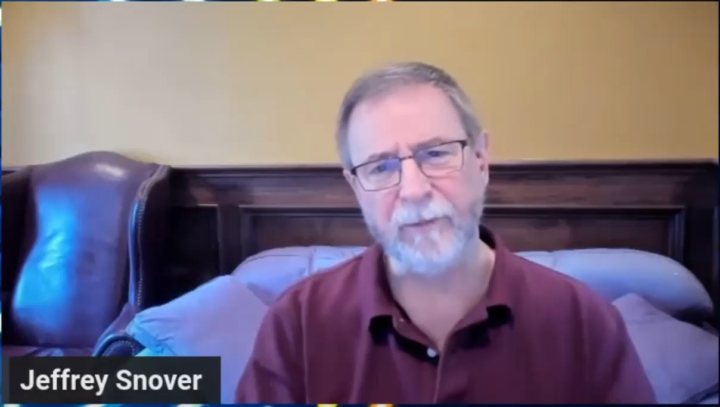

Slide 11

THANK YOU
Please review this session

